Slide 1

IndabaX: Machine learning welcome
Guy-alain ZODI Lusilao department of computer science
FACULTY of computing and informatics
NUST

Slide 2









Disruptive companies
differentiate by
Intelligent Applications
using
Machine Learning

Slide 3
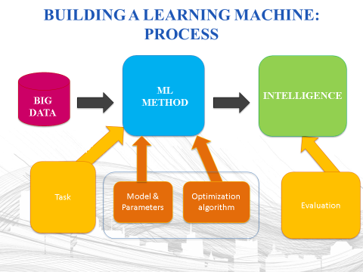
Machine learning pipeline
ML
METHOD
INTELLIGENCE
BIG
DATA

Slide 4
Machine learning
Subfield of AI
Provide new capabilities for computers
Examples
Database mining
Large database from growth of automation/web.
E.g. Web click data, medical records, biology and engineering
Robotics
E.g., autonomous helicopter, handwriting recognition, most of natural language processing (NLP), computer vision
Self customizing programs
E.g., Amazon, Netflix product recommendations
Understanding human learning (brains, real AI)

Slide 5
What is machine learning?
Tom Mitchel (1999). Well posed Learning.
Problem: a computer program is said to learn from experience E with respect to some task T and some performance measure P, if its performance on T, as measured by P, improves with experience E.
Example: Suppose your email program watches which emails you do or do not mark as spam , and based on that learns how to do better filter spam. What is the task T in this setting? The experience E? Performance P?
Classifying spam as spam and no spam
Watching you label email as spam or not spam
The number (or fraction) of emails correctly classified as spam or not spam
None of the above –this is not a machine learning problem
Notes:
LArthur Samuel (1959). Machine Learning: Field of study that gives computers the ability to learn without being explicitly programmed
earning without being explicitlly programme

Slide 6
Machine learning algorithms
Two type of learning algorithms
Supervised learning: teach a computer how to do something
Unsupervised learning; computer learns by itself how do something
Others: reinforcement learning, recommender system

Slide 7
SUPERVISED LEARNING

Slide 8
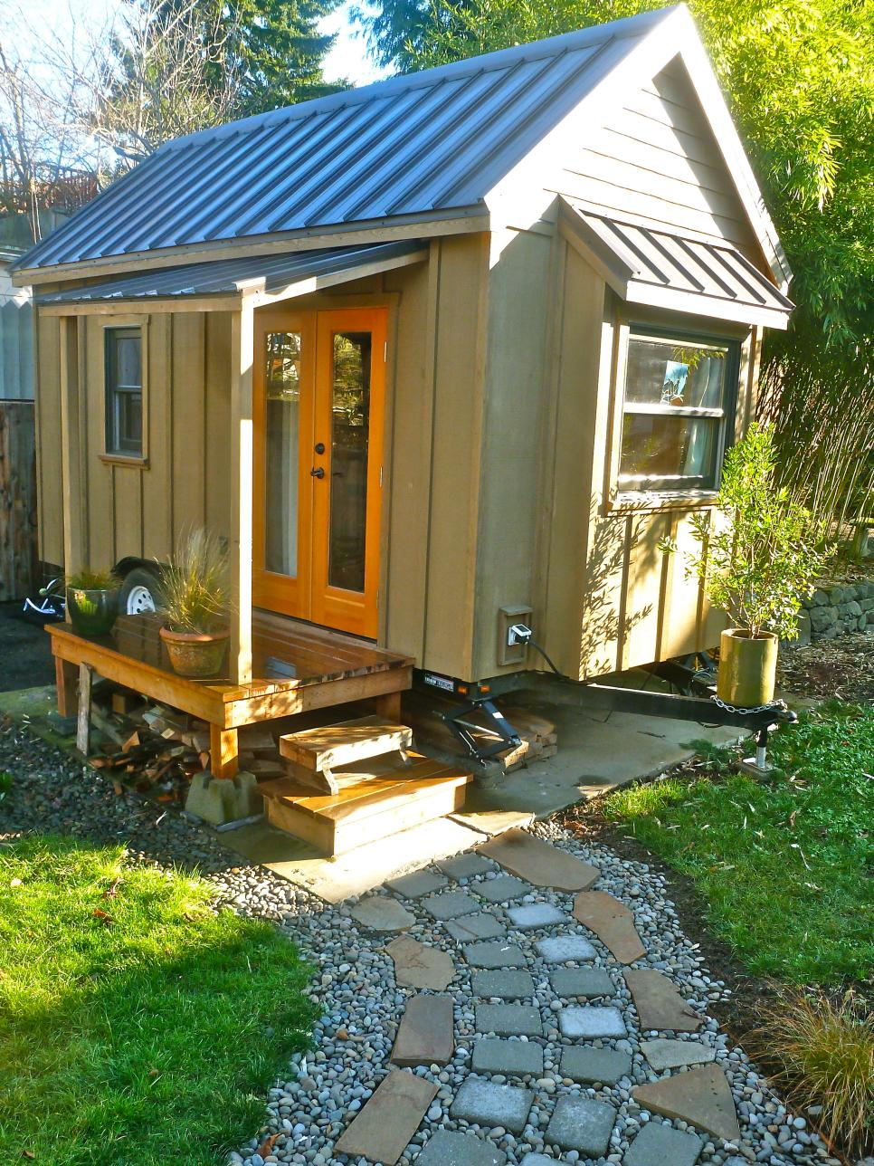
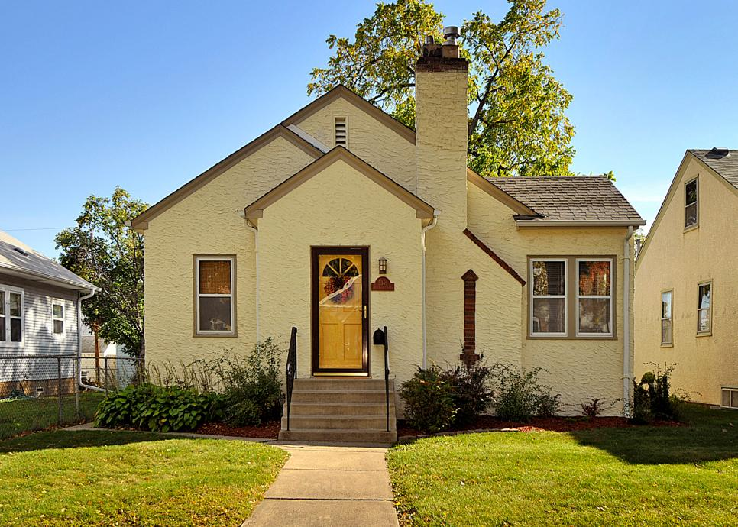
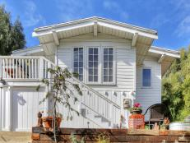
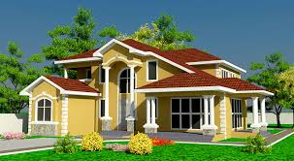
Example 1 predicting house prices
ML
METHOD
INTELLIGENCE
BIG
DATA
N$
N$
N$=??
N$
?
House features

Slide 9












Supervised learning
Housing price prediction
400
$$×$$
$$×$$
$$×$$
300
$$×$$
$$×$$
$$×$$
$$×$$
$$×$$
$$×$$
Price (N$)
In 1000
200
$$×$$
100
$$×$$
0
500
1000
1500
2000
2500
Size in $m^{2}$
Supervised Learning
Right answer is given
Regression: predict
Continuous value output (price)

Slide 10
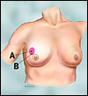
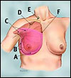
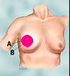
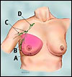
Example 2 breast cancer analysis
ML
METHOD
INTELLIGENCE
BIG
DATA
?
In which stage is the breast cancer?
Breast cancer features

Slide 11










Supervised learning
Breast cancer (malignant, benign)
Classification: discrete
Value output (0 or 1)
1(Y)
$$×$$
$$×$$
$$×$$
$$×$$
$$×$$
Generalisation:
0 malignant
1 type 1 cancer
2 type 2 cancer
3 type 3 cancer
4 type 4 cancer
Malignant?
0(N)
$$×$$
$$×$$
$$×$$
$$×$$
$$×$$
Tumour Size

Slide 12
Supervised learning
Age
Tumour size
Support vector machine allows you to deal with multiple features

Slide 13
Example
You are running a company, and want to develop learning algorithms to address each of two problems
Problem 1: you have a large inventory of identical items. You want to predict how many of these items will sell over the next 3 months
Problem2: you would like software to examine individual customer accounts, and for each account decide if it has been hacked/compromised
Should you treat this problem as classification or regression?
Treat both as classification problems
Treat problem 1 has a classification and problem 2 has a regression
Treat problem 1 as a regression, and problem 2 as a classification
Treat both as regression

Slide 14
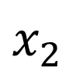
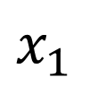
Unsupervised learning
$$x_{2}$$
clusters
$$x_{1}$$

Slide 15

Unsupervised learning

Slide 16
Example
Of the following examples, which would you address using an unsupervised learning algorithm? Check all that apply
Given an email label as a spam/not spam, learn a spam filter
Given a set of new articles found on the web, group them into set of articles about the same history
Given a database of customer data, automatically discover market segments and group customers into different market segments.
Given a dataset of patients diagnosed as either having diabetes or not, learn to classify new patients as having diabetes or not.

Slide 17
Building a learning machine: Process
ML
METHOD
INTELLIGENCE
BIG
DATA
Task
Task
Evaluation
Model & Parameters
Optimization algorithm
Evaluation

Slide 18
Example 1 predicting house prices
ML
METHOD
INTELLIGENCE
BIG
DATA
N$
N$
N$=??
N$
?
House features

Slide 19
REGRESSION
Models
Linear Regression
Algorithms
Gradient descent
Concepts
overfitting

Slide 20




























Linear regression with one variable
Housing price prediction
$$×$$
$$×$$
$$×$$
$$×$$
400
$$×$$
$$×$$
$$×$$
$$×$$
$$×$$
$$×$$
$$×$$
$$×$$
$$×$$
$$×$$
$$×$$
$$×$$
$$×$$
300
$$×$$
$$×$$
$$×$$
$$×$$
$$×$$
Price (N$)
In 1000
200
$$×$$
$$×$$
$$×$$
$$×$$
$$×$$
100
0
500
1000
1500
2000
2500
1250
Size in $m^{2}$
Supervised learning:
Given the right answer for each example in the data
Regression problem:
Predict real value output

Slide 21

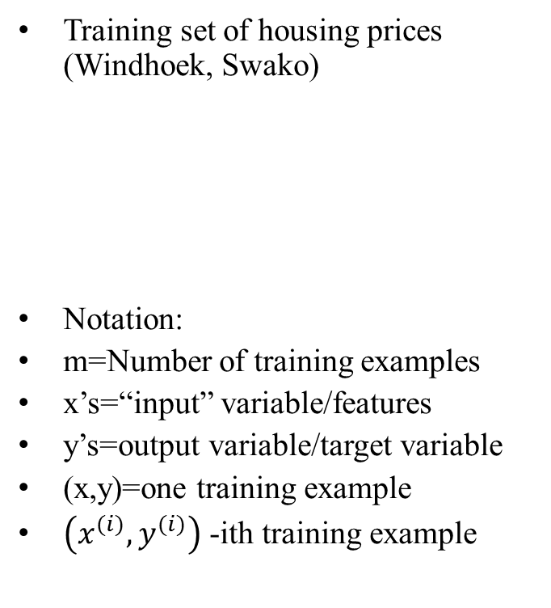
Regression with one variable
Size in $m^{2}$ (x)
Price(N$) in 1000 (y)
Training set of housing prices (Windhoek, Swako)
Notation:
m=Number of training examples
x’s=“input” variable/features
y’s=output variable/target variable
(x,y)=one training example
$\left(x^{(i)},y^{(i)}\right)$ -ith training example
2104 460
1416 232
1534 315
852 178

Slide 22
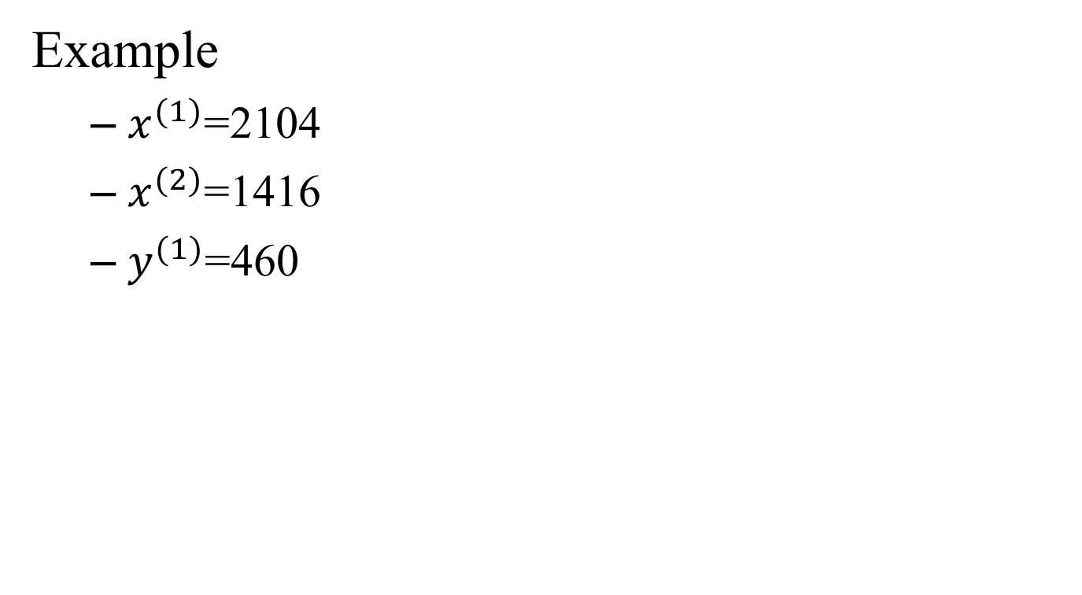
Regression with one variable
Example
$x^{(1)}$=2104
$x^{(2)}$=1416
$y^{(1)}$=460

Slide 23
model representation
TRAINING SET
(BIG DATA)
Learning Algorithm
A function that maps x’s to y’s
h
Size of house
Estimated price (in N$)

Slide 24
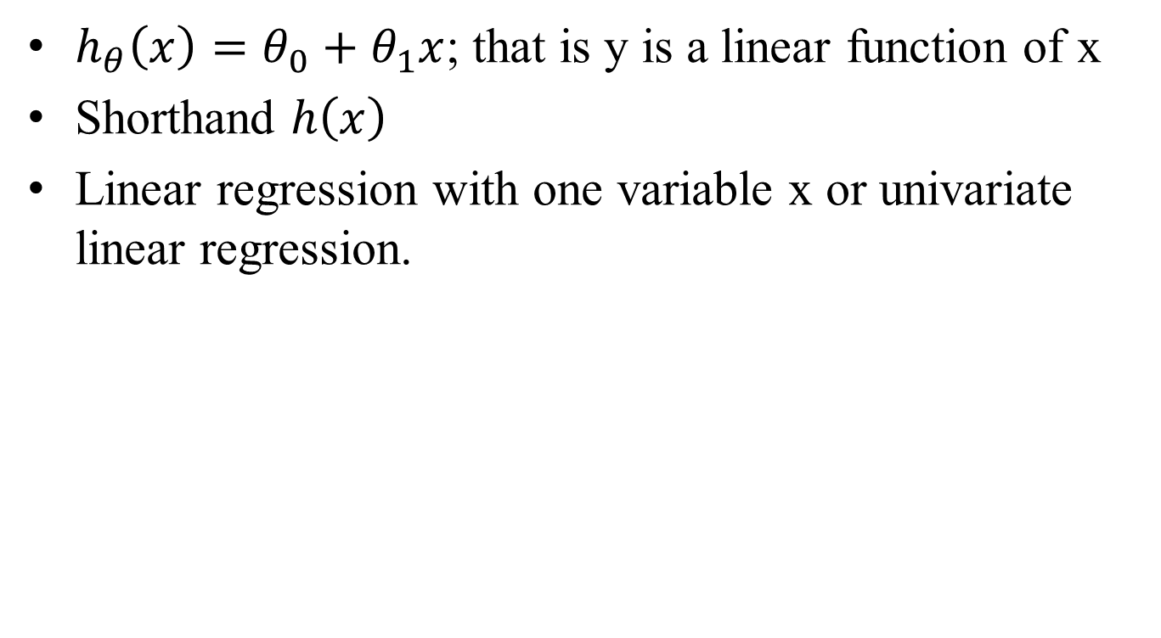

How do we represent the hypothesis $h$ ?
$h_{θ}\left(x\right)=θ_{0}+θ_{1}x$; that is y is a linear function of x
Shorthand $h\left(x\right)$
Linear regression with one variable x or univariate linear regression.

Slide 25
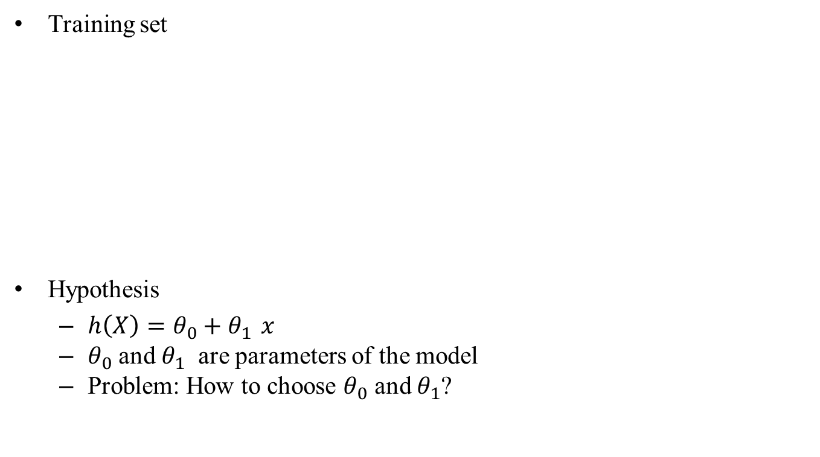
Linear regression with one variable-cost function
Training set
Hypothesis
$h\left(X\right)=θ_{0}+θ_{1 }x$
$θ_{0}$ and $θ_{1}$ are parameters of the model
Problem: How to choose $θ_{0}$ and $θ_{1}$?
Size in m2 (X) | Price in 1000’s (Y)
2104 | 460
1416 | 232
1534 | 315
852 | 178
…. | ….

Slide 26
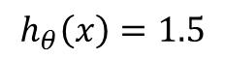
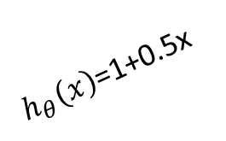
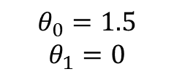
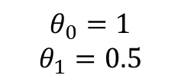
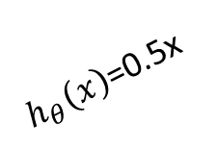
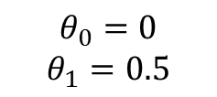
Choice of parameters
Different parameters lead to different hypothesis
$h_{θ}\left(x\right)$=1+0.5x
$$h_{θ}\left(x\right)=1.5$$
$h_{θ}\left(x\right)$=0.5x
$$θ_{0}=1.5$$
$$θ_{1}=0$$
$$θ_{0}=0$$
$$θ_{1}=0.5$$
$$θ_{0}=1$$
$$θ_{1}=0.5$$

Slide 27

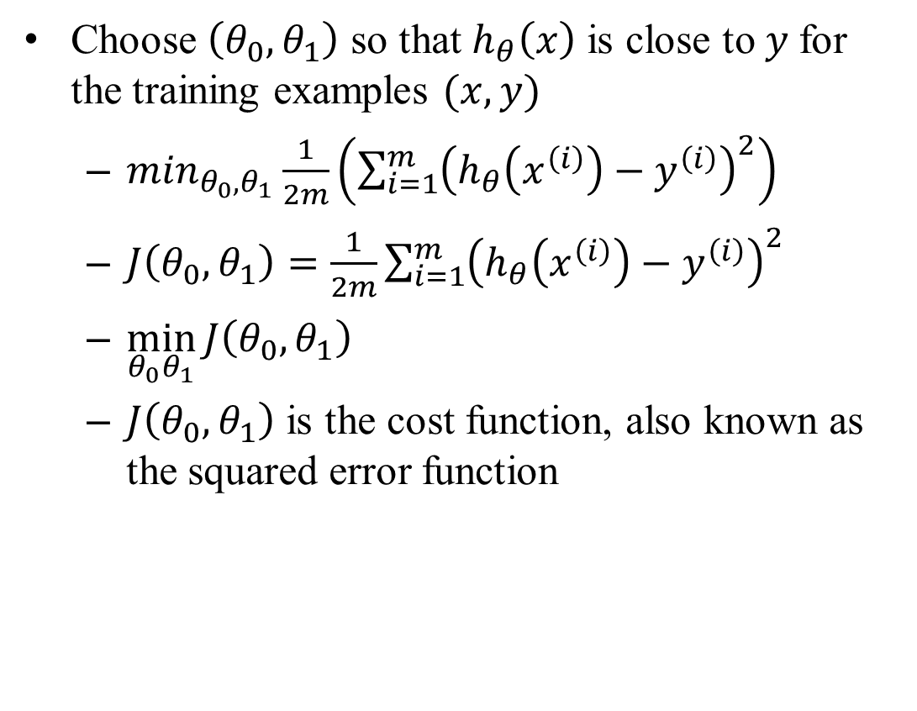





idea
Choose $\left(θ_{0},θ_{1}\right)$ so that $h_{θ}\left(x\right)$ is close to $y$for the training examples $(x,y)$
$\min_{θ_{0},θ_{1}}⁡\frac{1}{2m}\left(\sum_{i=1}^{m}{{\left(h_{θ}\left(x^{\left(i\right)}\right)−y^{\left(i\right)}\right)}^{2}}\right)$
$J\left(θ_{0},θ_{1}\right)=\frac{1}{2m}\sum_{i=1}^{m}{{\left(h_{θ}\left(x^{\left(i\right)}\right)−y^{\left(i\right)}\right)}^{2}}$
$\min_{θ_{0}θ_{1}}{J\left(θ_{0}, θ_{1}\right)}$
$J\left(θ_{0},θ_{1}\right)$ is the cost function, also known as the squared error function
y
$$×$$
$$×$$
$$×$$
$$×$$
$$×$$
$$×$$
x

Slide 28
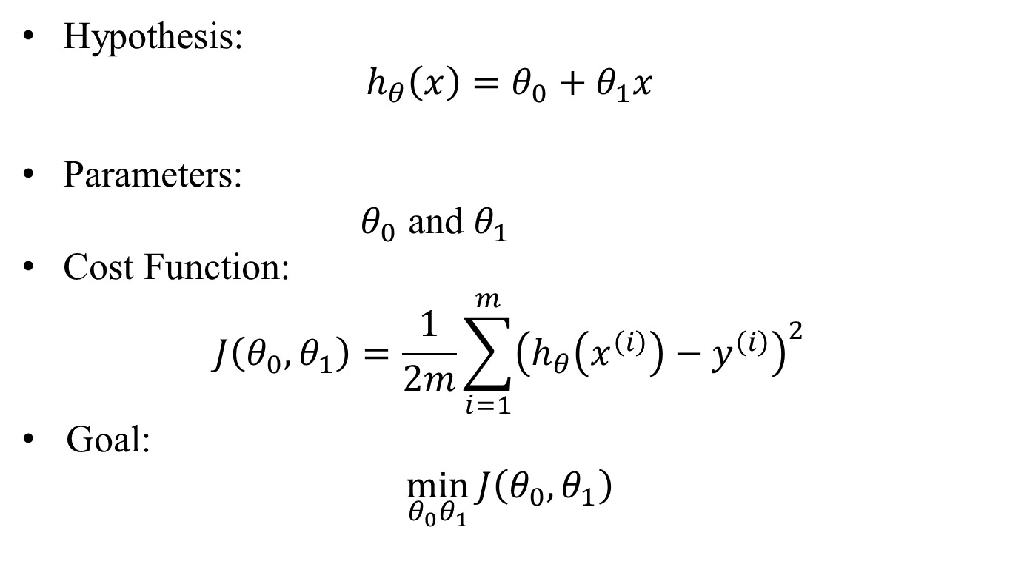
summary
Hypothesis:
$$h_{θ}\left(x\right)=θ_{0}+θ_{1}x$$
Parameters:
$θ_{0}$ and $θ_{1}$
Cost Function:
$$J\left(θ_{0},θ_{1}\right)=\frac{1}{2m}\sum_{i=1}^{m}{{\left(h_{θ}\left(x^{\left(i\right)}\right)−y^{\left(i\right)}\right)}^{2}}$$
Goal:
$$\min_{θ_{0}θ_{1}}{J\left(θ_{0}, θ_{1}\right)}$$

Slide 29
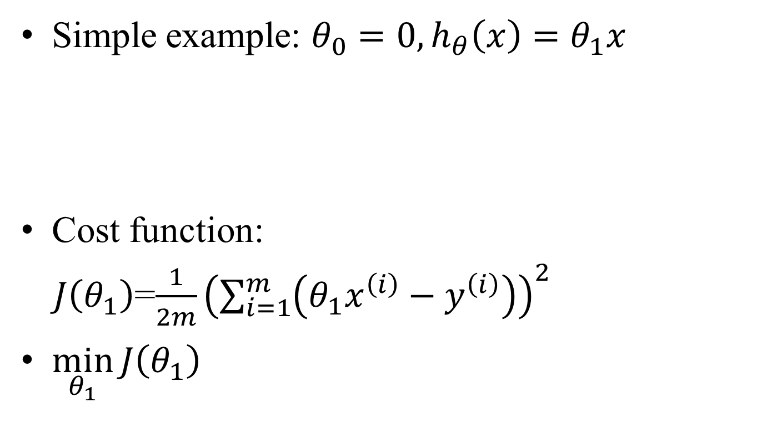
Visualization of cost function
Simple example: $θ_{0}=0, h_{θ}\left(x\right)=θ_{1}x$
Cost function:
$J\left(θ_{1}\right)$=$\frac{1}{2m}{\left(\sum_{i=1}^{m}{\left(θ_{1}x^{\left(i\right)}−y^{\left(i\right)}\right)}\right)}^{2}$
$\min_{θ_{1}}{J\left(θ_{1}\right)}$

Slide 30
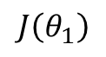
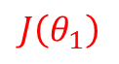
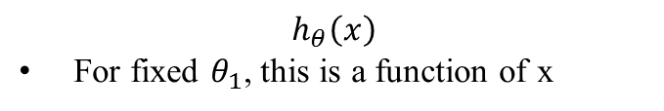
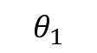
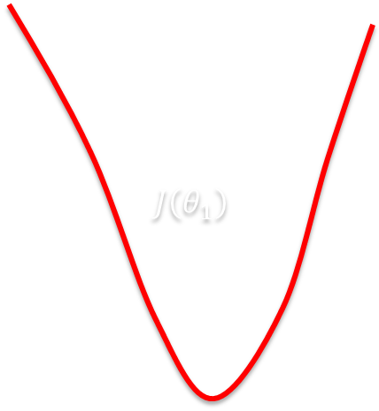
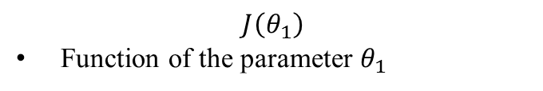

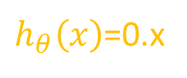
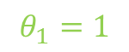
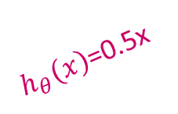
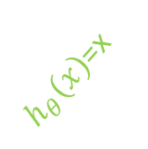

Simple examples
$$h_{θ}\left(x\right)$$
For fixed $θ_{1}$, this is a function of x
$$J\left(θ_{1}\right)$$
Function of the parameter $θ_{1}$
$h_{θ}\left(x\right)$=x
$$J\left(θ_{1}\right)$$
$$J\left(θ_{1}\right)$$
3
$$θ_{1}=1$$
$$J\left(θ_{1}\right)$$
y
2
$h_{θ}\left(x\right)$=0.5x
$$θ_{1}=0.5$$
1
$h_{θ}\left(x\right)$=0.x
0
0.5
1
1.5
2
2.5
3
x
What cost function correspond to $θ_{1}=1?$
$$θ_{1}$$

Slide 31
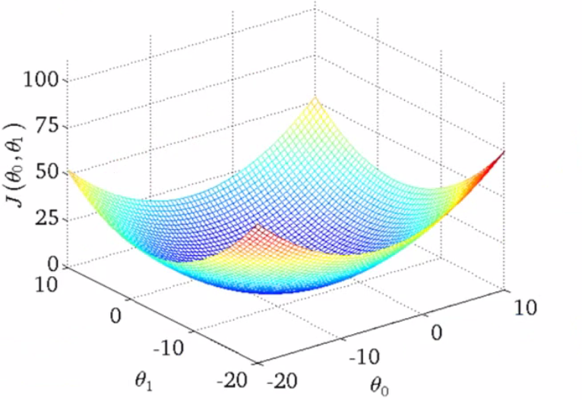
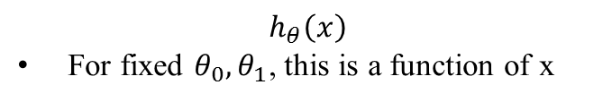
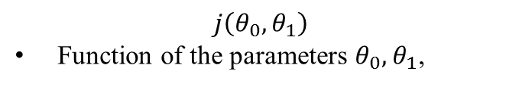
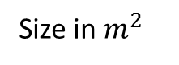
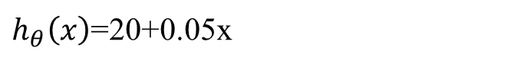
Cost function intuition
$$h_{θ}\left(x\right)$$
For fixed ${θ_{0}, θ}_{1}$, this is a function of x
$$j\left(θ_{0},θ_{1}\right)$$
Function of the parameters ${θ_{0}, θ}_{1}$,
800
700
600
500
400
Price in N$
300
200
100
0
1000
2000
3000
4000
5000
Size in $m^{2}$
$h_{θ}\left(x\right)$=20+0.05x

Slide 32
Cost function intuition

Slide 33
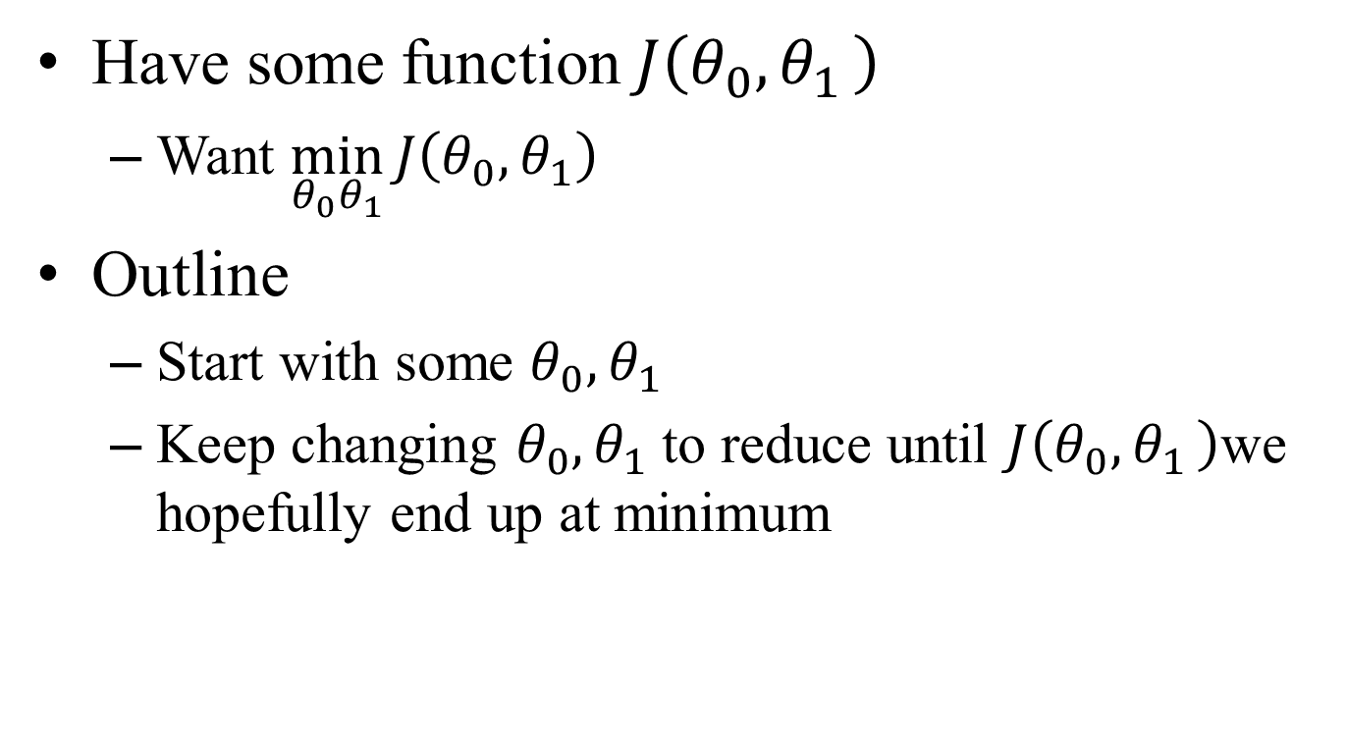
Linear regression with one variable-gradient descent
Have some function $J\left(θ_{0}{, θ}_{1}\right)$
Want $\min_{θ_{0}θ_{1}}{J\left(θ_{0}, θ_{1}\right)}$
Outline
Start with some $θ_{0}{, θ}_{1}$
Keep changing $θ_{0}{, θ}_{1}$to reduce until $J\left(θ_{0}{, θ}_{1}\right)$we hopefully end up at minimum

Slide 34
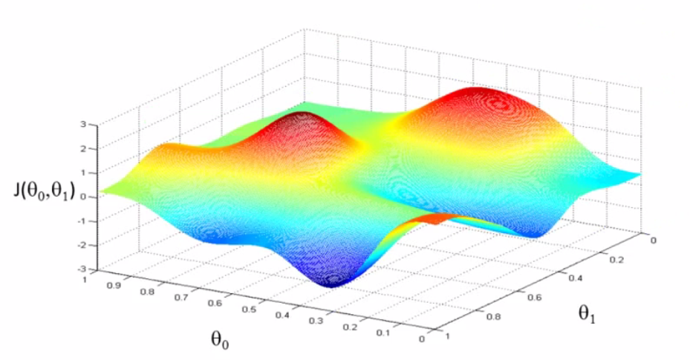
3D-representation of the cost function

Slide 35
3D-representation of the cost function

Slide 36
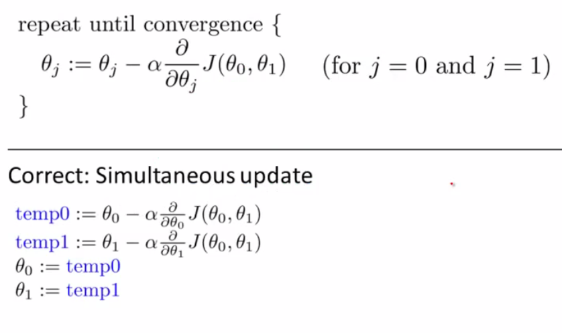
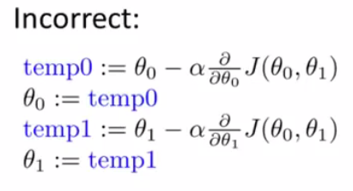
Gradient descent algorithm

Slide 37
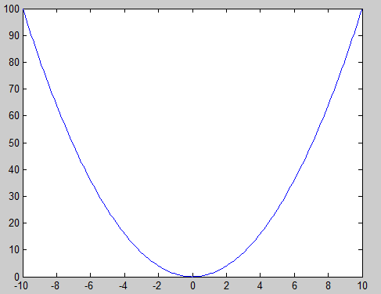
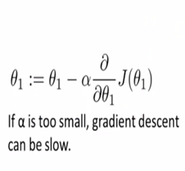
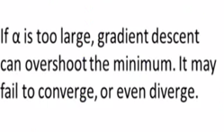
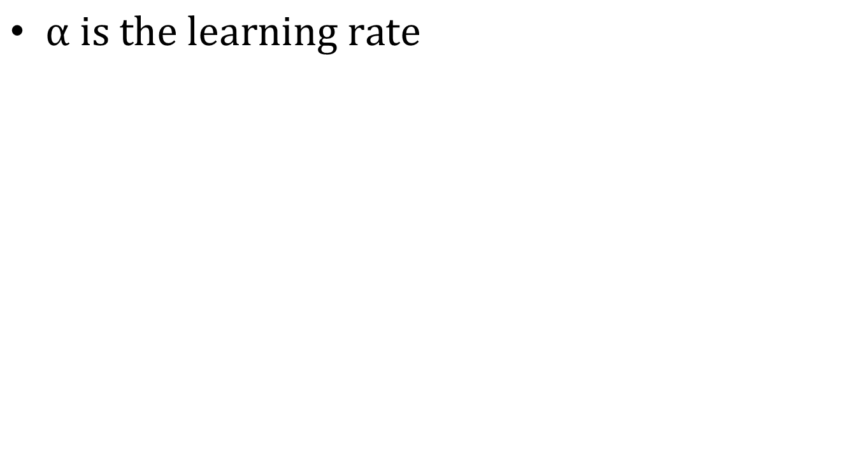
Learning rate
$α is the learning rate$

Slide 38
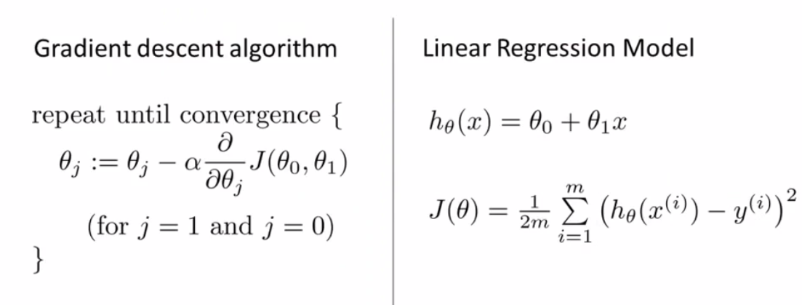
Gradient descent

Slide 39
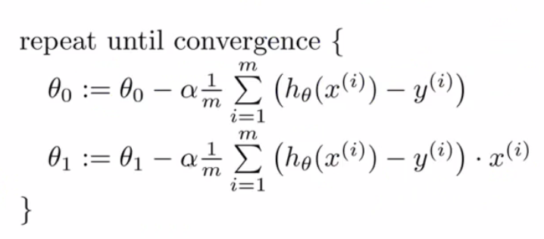
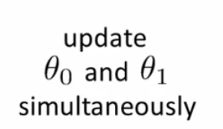
Gradient descent algorithm

Slide 40

Convex function

Slide 41


Two extensions
In min $J\left(θ_{0},θ_{1}\right)$ , solve $θ_{0},θ_{1}$exactly, without needing iterative algorithm (gradient descent)
Learn with larger number
Size (feet2) $$X_{1}$$ | Number of bedrooms $$X_{2}$$ | Number of floors $$X_{3}$$ | Age of home (years) $$X_{4}$$ | Price (1000$) Y
2104 | 5 | 1 | 45 | 460
1416 | 3 | 2 | 40 | 232
1534 | 3 | 2 | 30 | 315
852 | 2 | 1 | 36 | 178

Slide 42


Multiple features
Size (feet2) $$X_{1}$$ | Number of bedrooms $$X_{2}$$ | Number of floors $$X_{3}$$ | Age of home (years) $$X_{4}$$ | Price (1000$) Y
2104 | 5 | 1 | 45 | 460
1416 | 3 | 2 | 40 | 232
1534 | 3 | 2 | 30 | 315
852 | 2 | 1 | 36 | 178
Notation:
N = number of features
$x^{(i)}$= imput (features) of training $i^{th}$ examples
=value of features $j$ in training $i^{th}$ examples.

Slide 43

Multiple features
n=4
m=47
$x^{(2)}=\left[\begin{matrix}1416 \\ 3 \\ \begin{aligned}2 \\ 40\end{aligned}\end{matrix}\right]$

Slide 44

Hypothesis-multivariate linear regression
Previously: $h_{θ}\left(X\right)=θ_{0}+θ_{1}X$
Now
$$h_{θ}\left(X\right)=θ_{0}+θ_{1}X_{1}+θ_{2}X_{2}+θ_{3}X_{3}+θ_{4}X_{4}$$
Generalization:
$$h_{θ}\left(X\right)=θ_{0}+θ_{1}X_{1}+θ_{2}X_{2}+…+θ_{n}X_{n}$$
For convenience of notation, define $x_{0}=1.$

Slide 45



hypothesis
$X=\left[\begin{aligned}\begin{matrix}X_{0} \\ X_{1} \\ X_{2}\end{matrix} \\ ⋮ \\ X_{n}\end{aligned}\right]∈ℝ^{n+1}$
$θ=\left[\begin{aligned}\begin{matrix}θ_{0} \\ θ_{1} \\ θ_{2}\end{matrix} \\ ⋮ \\ θ_{n}\end{aligned}\right]∈ℝ^{n+1}$
$$h_{θ}\left(X\right)=θ_{0}+θ_{1}X_{1}+θ_{2}X_{2}+…+θ_{n}X_{n}$$
$$h_{θ}\left(X\right)=\left[\begin{matrix}θ_{0} & θ_{1} & …θ_{n}\end{matrix}\right]\left[\begin{matrix}X_{0} \\ X_{1} \\ \begin{aligned}⋮ \\ X_{n}\end{aligned}\end{matrix}\right]$$
$$h_{θ}\left(X\right)=θ^{T}X$$

Slide 46

Multivariate linear regression-hypothesis
Hypothesis: $h_{θ}\left(X\right)={θ^{T}X =θ}_{0}+θ_{1}X_{1}+θ_{2}X_{2}+…+θ_{n}X_{n}$
Parameters: $θ_{0},θ_{1}$, $θ_{2}$, $θ_{3}$,…, $θ_{n}= θ$(n+1)-dimensional
Cost function:
$J\left(θ_{0}{,θ}_{1}{,θ}_{2},…{,θ}_{n}\right)=\frac{1}{2m}\sum_{i=1}^{m}{{\left(h_{θ}\left(x^{(i)}\right)−y^{(i)}\right)}^{2}}$
Gradient descent
Repeat {
$$θ_{j}≔θ_{j}−α\frac{∂}{{∂θ}_{j}}J\left(θ_{0}{,θ}_{1}{,θ}_{2},…{,θ}_{n}\right)$$
}
Simultaneously update for every $j=0,……, n$

Slide 47

Gradient descent
n=1
Repeat {
$$θ_{0}≔θ_{0}−α\frac{1}{2m}\sum_{i=1}^{m}{\left(h_{θ}\left(x^{(i)}\right)−y^{(i)}\right)}$$
$$θ_{1}≔θ_{1}−α\frac{1}{2m}\sum_{i=1}^{m}{\left(h_{θ}\left(x^{(i)}\right)−y^{(i)}\right)}x^{(i)}$$
Simultaneously update $θ_{0}$, $θ_{1}$
}

Slide 48

Multivariate Regression-Gradient descent
$n≥1$
Repeat {
$$θ_{j}≔θ_{j}−α\frac{1}{2m}\sum_{i=1}^{m}{\left(h_{θ}\left(x^{(i)}\right)−y^{(i)}\right)}x^{(i)}$$
Simultaneously update ($θ_{j}$ , j=0,1,….n)
}
$θ_{0}≔θ_{0}−α\frac{1}{2m}\sum_{i=1}^{m}{\left(h_{θ}\left(x^{(i)}\right)−y^{(i)}\right)}x^{(i)}$
$θ_{1}≔θ_{1}−α\frac{1}{2m}\sum_{i=1}^{m}{\left(h_{θ}\left(x^{(i)}\right)−y^{(i)}\right)}x^{(i)}$
$θ_{2}≔θ_{2}−α\frac{1}{2m}\sum_{i=1}^{m}{\left(h_{θ}\left(x^{(i)}\right)−y^{(i)}\right)}x^{(i)}$

Slide 49








FeaturES scaling
Idea: make sure the features are on similar scale
E.g. $x_{1}$=size(0-2000$m^{2}$)
$x_{2}$=number of bedrooms(1-5)
E.g. $x_{1}$=$\frac{size(m^{2})}{2000}$
$x_{2}$=$\frac{number of bedrooms}{5}$
$$J\left(θ\right)$$
$$J\left(θ\right)$$
$$θ_{2}$$
$$θ_{2}$$
$$θ_{1}$$
$$θ_{1}$$

Slide 50

Feature scaling
Get every feature into approximately a $−1≤x_{i}≤1$ range
Mean normalization
Replace $x_{i}$ with $x_{i}−μ_{i}$ to make features have approximately zero mean (Do not apply to $x_{0}=1$)
Scale the features using: $x_{i}=\frac{x_{i}−μ_{i}}{S_{i}}, where{ S}_{i} is the range or standard deviation.$
E.g. $x_{1}=\frac{size−1000}{2000};x_{2}=\frac{\#bedrooms−2}{5}$
$$−0.5≤x_{1}≤0.5, −0.5≤x_{2}≤0.5$$

Slide 51






Gradient descent
Example automatic convergence test:
declare convergence if $J\left(θ\right)$ decreases by less than ${10}^{−3}$
in one iteration.
Gradient descent not working: Use smaller $α$
For sufficiently small $α$, $J\left(θ\right)$should decrease in every iteration
But if $α$ is too small, gradient descent can be slow to converge
$$θ_{j}=θ_{j}−α\frac{∂}{∂θ_{j}}J\left(θ\right)$$
Debugging: how to make sure gradient descent is working?
how to choose learning rate $α?$
$$J(θ)$$
$$\min_{θ}J(θ)$$
$$θ$$
0
100
200
300
$$number of iterations$$

Slide 52

summary
If $α$is too small; $J\left(θ\right)$has slow convergence
If $α$is too large : $J\left(θ\right)$ may not decrease on very iteration ; may not converge
To choose try the following values:0.001, 0.003, 0.01, 0.03, 0.1, 0.3, 1,….

Slide 53

Features and polynomial regression
Housing price prediction $h_{θ}\left(X\right)=θ_{0}+θ_{1}×frontage+θ_{2}×depth$
Area = $frontage$ $×depth$
Can also be predicted using $h_{θ}\left(X\right)=θ_{0}+θ_{1}×frontage+θ_{2}×area$
$h_{θ}\left(X\right)=θ_{0}+θ_{1}X+θ_{2}X^{2}$

Slide 54




Polynomial regression
Housing price prediction
400
$$×$$
$$×$$
$$×$$
$$θ_{0}+θ_{1}x+θ_{2}x^{2}$$
300
$$×$$
$$×$$
$$×$$
$$×$$
$$×$$
$$×$$
Price (N$)
In 1000
200
$$×$$
$$θ_{0}+θ_{1}x+θ_{2}x^{2}+θ_{3}x^{3}$$
100
$$×$$
0
500
1000
1500
2000
2500
Size in $m^{2}$
$$h_{θ}\left(x\right)=θ_{0}+θ_{1}x_{1}+θ_{2}x_{2}+θ_{3}x_{3}$$
$=θ_{0}+θ_{1}(size)+θ_{2}{(size)}^{2}$ $+θ_{3}{(size)}^{3}$
$$x_{1}=size$$
$$x_{2}={(size)}^{2}$$
$$x_{3}={(size)}^{3}$$

Slide 55

Polynomial regression
Housing price prediction
400
$$×$$
$$×$$
$$×$$
$$θ_{0}+θ_{1}x+θ_{2}x^{2}$$
300
$$×$$
$$×$$
$$×$$
$$×$$
$$×$$
$$×$$
Price (N$)
In 1000
200
$$×$$
100
$$×$$
0
500
1000
1500
2000
2500
Size in $m^{2}$
$$h_{θ}\left(x\right)=θ_{0}+θ_{1}(size)+θ_{2}\sqrt{size}$$

Slide 56



Normal equation
Gradient descent
Method to solve for$θ$analytically
$$J(θ)$$
$$θ$$

Slide 57


examples
m=4
$X=\left[\begin{matrix}1 \begin{matrix}2104 & 5\end{matrix}\begin{matrix} 1 & 15\end{matrix} \\ 1 \begin{matrix}1416 & 3\end{matrix}\begin{matrix} 2 & 40\end{matrix} \\ \begin{aligned}1 \begin{matrix}1534 & 3\end{matrix}\begin{matrix} 2 & 30\end{matrix} \\ 1 \begin{matrix} 852 & 2\end{matrix}\begin{matrix} 1 & 36\end{matrix}\end{aligned}\end{matrix}\right]$ Y=$\left[\begin{aligned}460 \\ 232 \\ 315 \\ 178\end{aligned}\right]$
$θ={\left(X^{T}X\right)}^{−1}X^{T}$y
$$x_{0}$$ | Size($m^{2}$) $$x_{1}$$ | Number of bedrooms $$x_{2}$$ | Number of floors $$x_{3}$$ | Age of home $$x_{4}$$ | Price(1000N$) $$y$$
1 | 2104 | 5 | 1 | 15 | 460
1 | 1416 | 3 | 2 | 40 | 232
1 | 1534 | 3 | 2 | 30 | 315
1 | 852 | 2 | 1 | 36 | 178

Slide 58
classification
Models
Linear Classifiers (Logistic Regression)
Algorithms
Gradient descent (stochastic gradient)
Concepts
Decision Boundaries

Slide 59

Logistic regression
Classification
Email: spam or not spam?
Online transaction: fraudulent or not?
Tumor: malign or benign?
$y∈\left\{0,1\right\}$
$0$ : negative class (e.g., benign tumor)
1: positive class (e.g. malignant tumor)
Can be generalized for multiple class ($≥2$)
$y∈\left\{0,1, 2, 3, 4\right\}$

Slide 60


Logistic regression
Why not use linear regression?
Threshold classifier output $h_{θ}\left(x\right)$ at 0.5
If $h_{θ}\left(x\right)≥0.5$ , predict “y=1”
If $h_{θ}\left(x\right)<0.5$, predict “y=0”
$$h_{θ}\left(X\right)=θ^{T}X$$
yes 1
Malignant?
0.5
No 0
Tumor size

Slide 61

Logistic regression
Classification: y = 0 or y=1
$h_{θ}\left(X\right) c$an be > 1 or < 0
Logistic regression $0≤h_{θ}\left(x\right)≤1$
$$h_{θ}\left(X\right)=θ^{T}X$$
yes 1
Malignant?
No 0

Slide 62

hypothesis representation
We want $0≤h_{θ}\left(x\right)≤1$
$h_{θ}\left(x\right)=g\left(θ^{T}x\right)$
$g\left(z\right)=\frac{1}{1+e^{−z}}$
Sigmoid function or
Logistic function
$h_{θ}\left(x\right)=g\left(θ^{T}x\right)=\frac{1}{1+e^{−θ^{T}x}}$
1
g(z)
0.5

Slide 63


Interpretation of $h_{θ}\left(x\right)$
$h_{θ}\left(x\right)=$estimate probability that y=1 on input x
Example: if $x=\left[\begin{matrix}x_{0} \\ x_{1}\end{matrix}\right]$=$\left[\begin{matrix}1 \\ tumorSize\end{matrix}\right]$
$h_{θ}\left(x\right)=$0.7
Tell patient that 70%chance of tumor being malignant
$h_{θ}\left(x\right)=P\left(y=1|x;θ\right)$; probability that y=1, given xx, parameterized by $θ$.
y=0 or y=1
$P\left(y=0|x;θ\right)+P\left(y=1|x;θ\right)\text{=1;}$
$P\left(y=0|x;θ\right)$; $h_{θ}\left(x\right)=1−P\left(y=1|x;θ\right)$;

Slide 64

Decision boundary
$h_{θ}\left(x\right)=g\left(θ^{T}x\right)$= $P\left(y=1|x;θ\right)$
$g\left(z\right)=\frac{1}{1+e^{−z}}$
Suppose predict
y=0 if $h_{θ}\left(x\right)<0.5$; that is $\left(θ^{T}x\right)<0$
“y=1” if $h_{θ}(x)≥0.5$; that is $\left(θ^{T}x\right)$ $≥$0
g(z)
1
0.5
0

Slide 65



Decision boundary
3
$$x_{2}$$
2
1
0
1
3
$$x_{1}$$
2
$h_{θ}(x)=g\left(θ_{0}+θ_{1}x_{1}+θ_{2}x_{2}\right)$
${if θ}_{0}=−3;θ_{1}=1;θ_{2}=1;$
$predicts y=1 if −3+x_{1}+x_{2}≥0;that is x_{1}+x_{2}$ $≥3$

Slide 66

Non linear decision boundary
$h_{θ}\left(x\right)=g\left(θ_{0}+θ_{1}x_{2}+θ_{2}x_{2}+θ_{3}x_{}^{2}+θ_{4}x_{}^{3}\right)$
Predict “y=1” if $−1+x_{}^{2}+x_{}^{2}≥0$
$x_{}^{2}+x_{}^{2}≥1$
More shape:
$$h_{θ}\left(x\right)=g\left(θ_{0}+θ_{1}x_{2}+θ_{2}x_{2}+θ_{3}x_{}^{2}+θ_{4}x_{}^{2}x_{2}^{}+θ_{5}x_{1}^{}x_{2}^{}+θ_{6}x_{1}^{}x_{2}^{}+….\right)$$
Y=1
Y=0

Slide 67

Cost function
Training set:
$$\left\{\left(x^{(1)},y^{(1)}\right),\left(x^{(2)},y^{(2)}\right),\left(x^{(3)},y^{(3)}\right),…\left(x^{(m)},y^{(m)}\right)\right\}$$
M examples $x∈\left[\begin{aligned}\begin{aligned}\begin{matrix}x_{0} \\ x_{1}\end{matrix} \\ …\end{aligned} \\ x_{n}\end{aligned}\right] x_{0}=1,y∈\left\{0,1\right\}$
$h_{θ}\left(x\right)=\frac{1}{1+e^{{−θ}^{T}x}}$
How to choose parameter $θ?$

Slide 68



Cost function
No convex
J$\left(θ\right)$
Linear regression
$J(θ)=\frac{1}{m}\sum_{i=1}^{m}{\frac{1}{2}{\left(h_{θ}\left(x^{\left(i\right)}\right)−y^{\left(i\right)}\right)}^{2}}$
. Defining cost$\left(x^{\left(i\right)}{,y}^{\left(i\right)}\right)=\frac{1}{2}{\left(h_{θ}\left(x^{\left(i\right)}\right)−y^{\left(i\right)}\right)}^{2}$then
Convex
J$\left(θ\right)$

Slide 69

Logistic regression cost function
$cost\left(h_{θ}\left(x\right),y\right)=\left\{\begin{matrix}−log\left(h_{θ}\left(x\right)\right) if y=1 \\ −log\left(1−h_{θ}\left(x\right)\right) if y=0\end{matrix}\right.$
Cost=0 if y=1, $h_{θ}\left(x\right)=1, however as \lim_{Cost→∝}{h_{θ}\left(x\right)}$=0
Capture intuition that if $h_{θ}\left(x\right)$=0 predicts ($P\left(y=0 | x;θ\right)=0$), but y=1, we will penalize learning algorithm by a very large cost.

Slide 70

Simplified cost function and gradient descent
$J(θ)=\frac{1}{m}\sum_{i=1}^{m}{\frac{1}{2}{\left(h_{θ}\left(x^{\left(i\right)}\right)−y^{\left(i\right)}\right)}^{2}}$
$cost\left(h_{θ}\left(x\right),y\right)=\left\{\begin{matrix}−log\left(h_{θ}\left(x\right)\right) if y=1 \\ −log\left(1−h_{θ}\left(x\right)\right) if y=0\end{matrix}\right.$
Note $y=0 or y=1$
$cost\left(h_{θ}\left(x\right),y\right)$= $−ylog\left(h_{θ}\left(x\right)\right) −(1−y)log\left(1−h_{θ}\left(x\right)\right)$
If $y=1: cost\left(h_{θ}\left(x\right),y\right)$= $−log\left(h_{θ}\left(x\right)\right)$
If $y=0:$ $cost\left(h_{θ}\left(x\right),y\right)$= $−log\left(1−h_{θ}\left(x\right)\right)$
$J\left(θ\right)=−\frac{1}{m}\left\{\sum_{i=1}^{m}{−y^{(i)}log\left(h_{θ}\left(x^{(i)}\right)\right) −(1−y^{(i)})log\left(1−h_{θ}\left(x^{(i)}\right)\right) }\right\}$

Slide 71

Simplified cost function and gradient descent
To fit parameter:
$$\min_{θ}{J\left(θ\right)}$$
To make prediction given new x:
Output $h\left(θ\right)$=$\frac{1}{1+e^{−θ^{T}x}}$

Slide 72

Simplified cost function and gradient descent
$J\left(θ\right)=−\frac{1}{m}\left\{\sum_{i=1}^{m}{−y^{(i)}log\left(h_{θ}\left(x^{(i)}\right)\right) −(1−y^{(i)})log\left(1−h_{θ}\left(x^{(i)}\right)\right) }\right\}$
$Want \min_{θ}{J\left(θ\right)}$:
Gradient descent
Repeat {
$$θ_{j}≔θ_{j}−α\frac{∂}{{∂θ}_{j}}J\left(θ\right)$$
}
Simultaneously update all $θ_{j}$

Slide 73

Simplified cost function and gradient descent
$J\left(θ\right)=−\frac{1}{m}\left\{\sum_{i=1}^{m}{−y^{(i)}log\left(h_{θ}\left(x^{(i)}\right)\right) −(1−y^{(i)})log\left(1−h_{θ}\left(x^{(i)}\right)\right) }\right\}$
$Want \min_{θ}{J\left(θ\right)}$:
Repeat {
$$θ_{j}≔θ_{j}−α\sum_{i=1}^{m}{\left(h_{θ}\left(x^{(i)}\right)−y^{(i)}\right)}x_{}^{i}$$
}
Simultaneously update all $θ_{j}$
Algorithm looks identical to linear regression
$h_{θ}\left(x\right)=θ^{T}x→h_{θ}(x)=\frac{1}{1+e^{−θ^{T}x}}$

Slide 74

Advance regression
Optimization algorithm
Cost function $J\left(θ\right).$ Want $\min_{θ}{J\left(θ\right)}$
Given $θ$, we have code to compute
$J\left(θ\right)$
$\frac{∂}{{∂θ}_{j}}J\left(θ\right)$ (for j=0,1,…,n)
Gradient descent
Repeat {
$$θ_{j}≔θ_{j}−α\frac{∂}{{∂θ}_{j}}J\left(θ\right)$$
}

Slide 75


Optimization algorithm
Given , we have code that can compute
$J\left(θ\right)$
$\frac{∂}{{∂θ}_{j}}J\left(θ\right)$
Optimization algorithms:
Gradient descent
Conjugate gradient
BFGS
L-BFGS
Advantages
No need to manually pick $α$
Often faster than gradient descent
disadvantage
More complex

Slide 76
example

Slide 77
Multiple classification
Binary classification
Email foldering: work, friend, family, hobby
Medical diagrams: not ill, cold, flu
Weather: sunny, cloudy, rain, snow
Multi-classification classification

Slide 78
One vs all
Class 1:
Class 2:
Class 3:

